Slide 1

Well Drilling Data Analysis and Prediction
https://well0data.herokuapp.com/
Un- supervised ML
Gathering
Cleaning
Analysis
Supervised ML

Slide 2




pandas
Data science related libraries are used, to perform the required procedures, and get a valuable output easily.

Slide 3
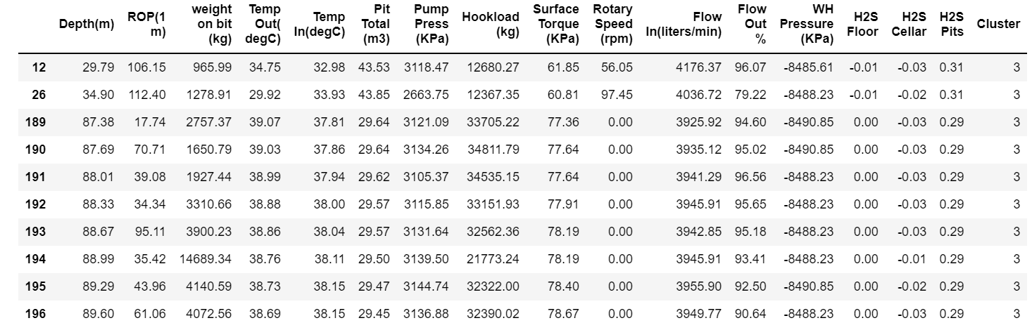
A drilling data is gathered and analyzed along the path taken down the well. So, recording;
Torque required for drilling
H2S levels
Temperature
Pressure, etc.

Slide 4
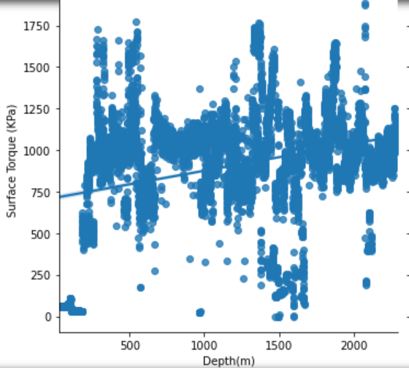
Exploratory Analysis
Depth of well is found causing a higher torque (KPa) applied from the surface by the drilling rig.

Slide 5
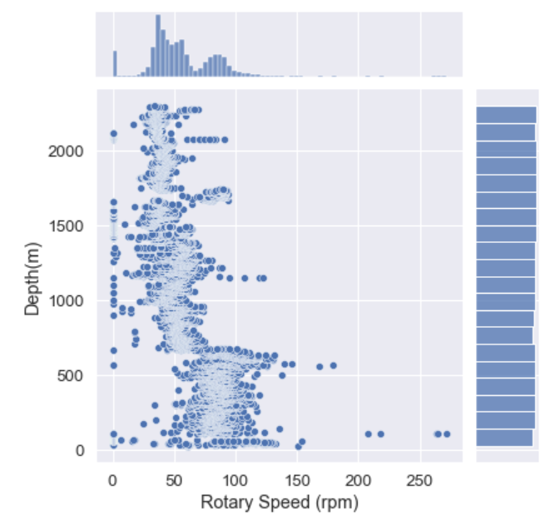
Exploratory Analysis
Depth of well is found causing a lower speed for the drilling rig.

Slide 6
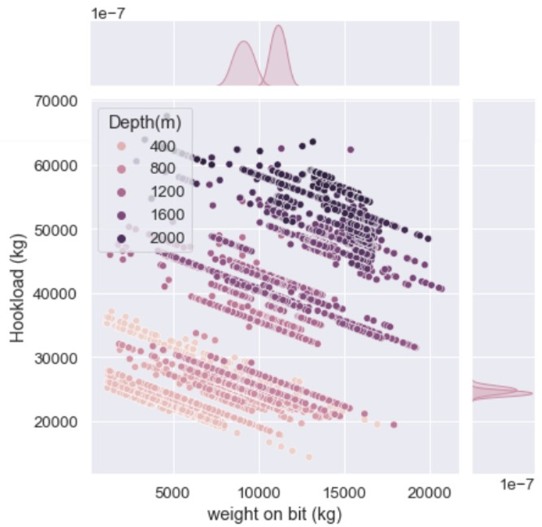
Strong negative relation between piping load being hanged, and rested on the drill bit

Slide 7
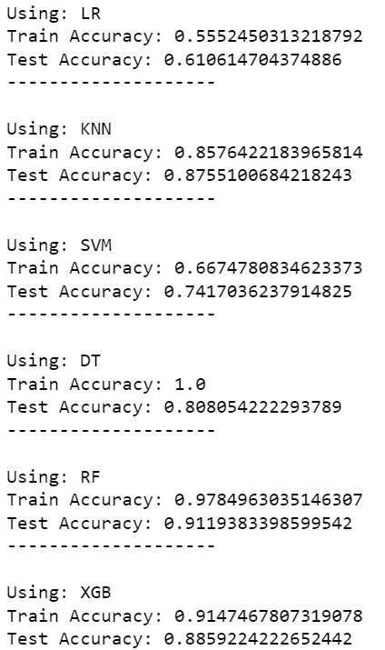
Machine Learning
ML supervised algorithms are applied to predict the ROP as the indication for the drilling speed.
So, by using Random Forest Regressor, we can predict the ROP for a new data.

Slide 8
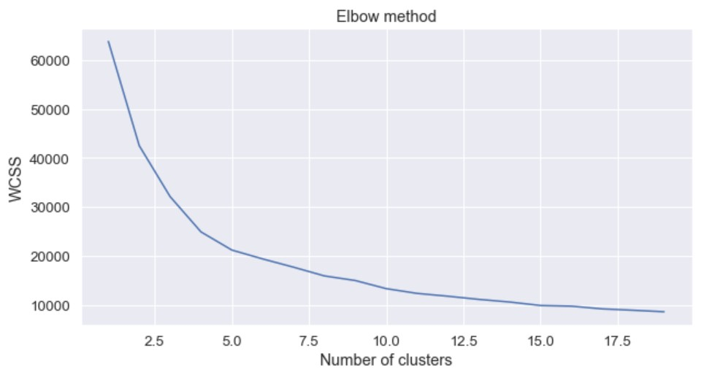
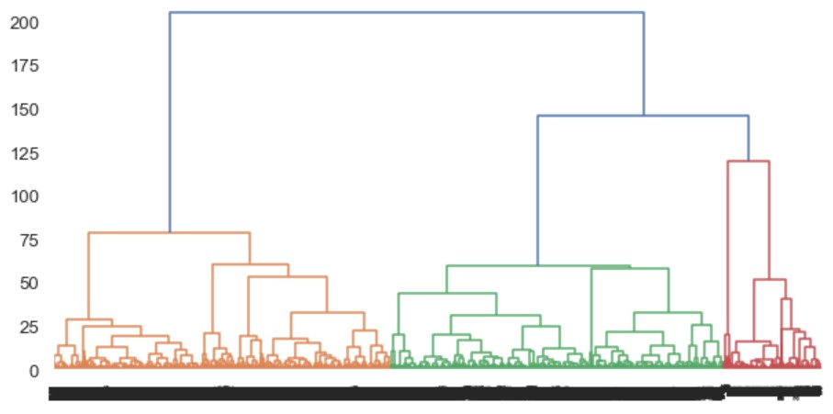
Machine Learning
Our data is used with some independent variables inside the ML algorithms. We are trying to categorize the ground formation from the drilling recordings of the well. So, it's unsupervised learning.
We got 5 categories clustering the whole dataset.

Slide 9
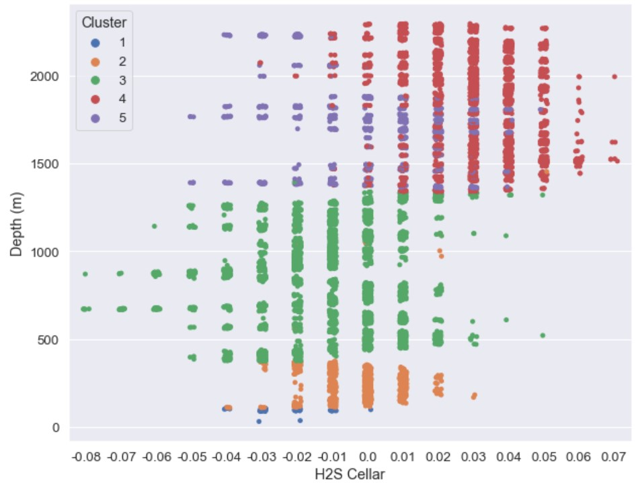
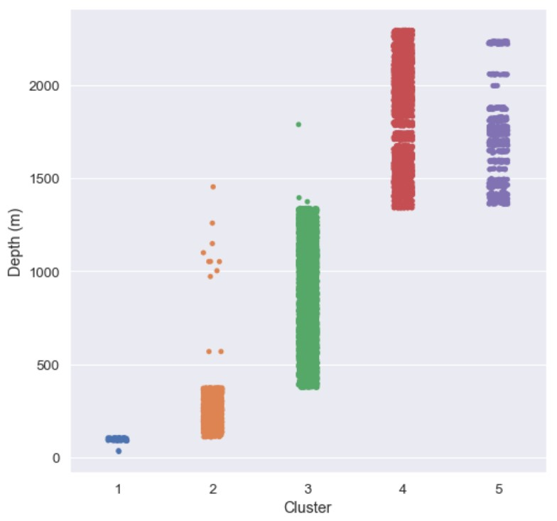
Categories (1 – 5) vs. well depth
Graph showing: each Cluster represent a specific depth
Categories (1 – 5) vs.H2S levels captured
Graph showing: each Cluster representing range of levels as per depth down

Slide 10
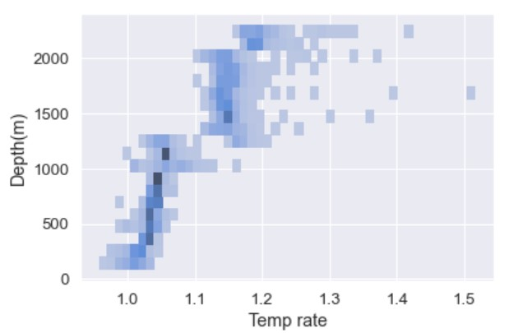
Temperature differences from the input and output mud are increasing with the depth

Slide 11
Next steps:
More data for different wells, shall increase the reliability of the application.
Additional information for the ground geographies can help in more meaningful clustering.

